Slide 2
Format
<region>
PNAS; sspen
PNAS; ss
PNAS; ll
LANCET; sspen
LANCET; ss
LANCET; ll

Slide 3
Notes
Setup
5x initial parameter conditions (bound_rand_vec * min_cond)
Min are bounded at 0
Max are bounded by the initial minimization search step’s upper bound
5x chains
25000 length ea
4x chain reiterations (initial output is set as new chain start 4x times)
5000 iterations per chain
RES
LANCET parameters seem to be better
Re-run with only LANCET parms but do a broader search?

Slide 4
wash

Slide 5
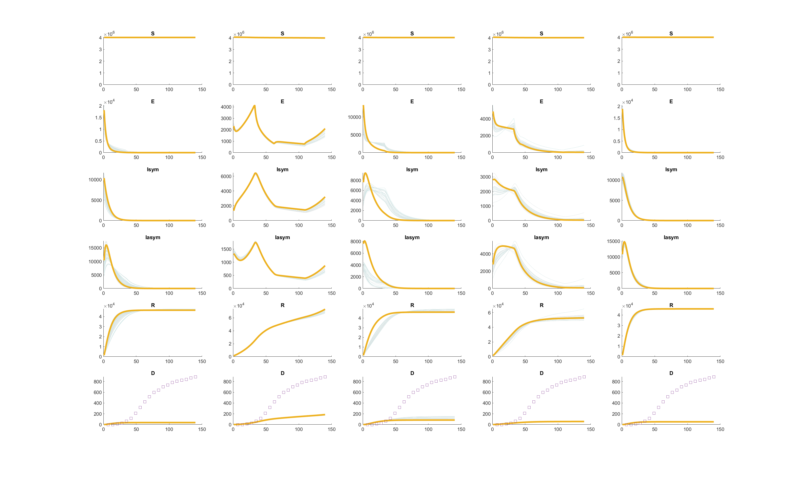

Slide 6
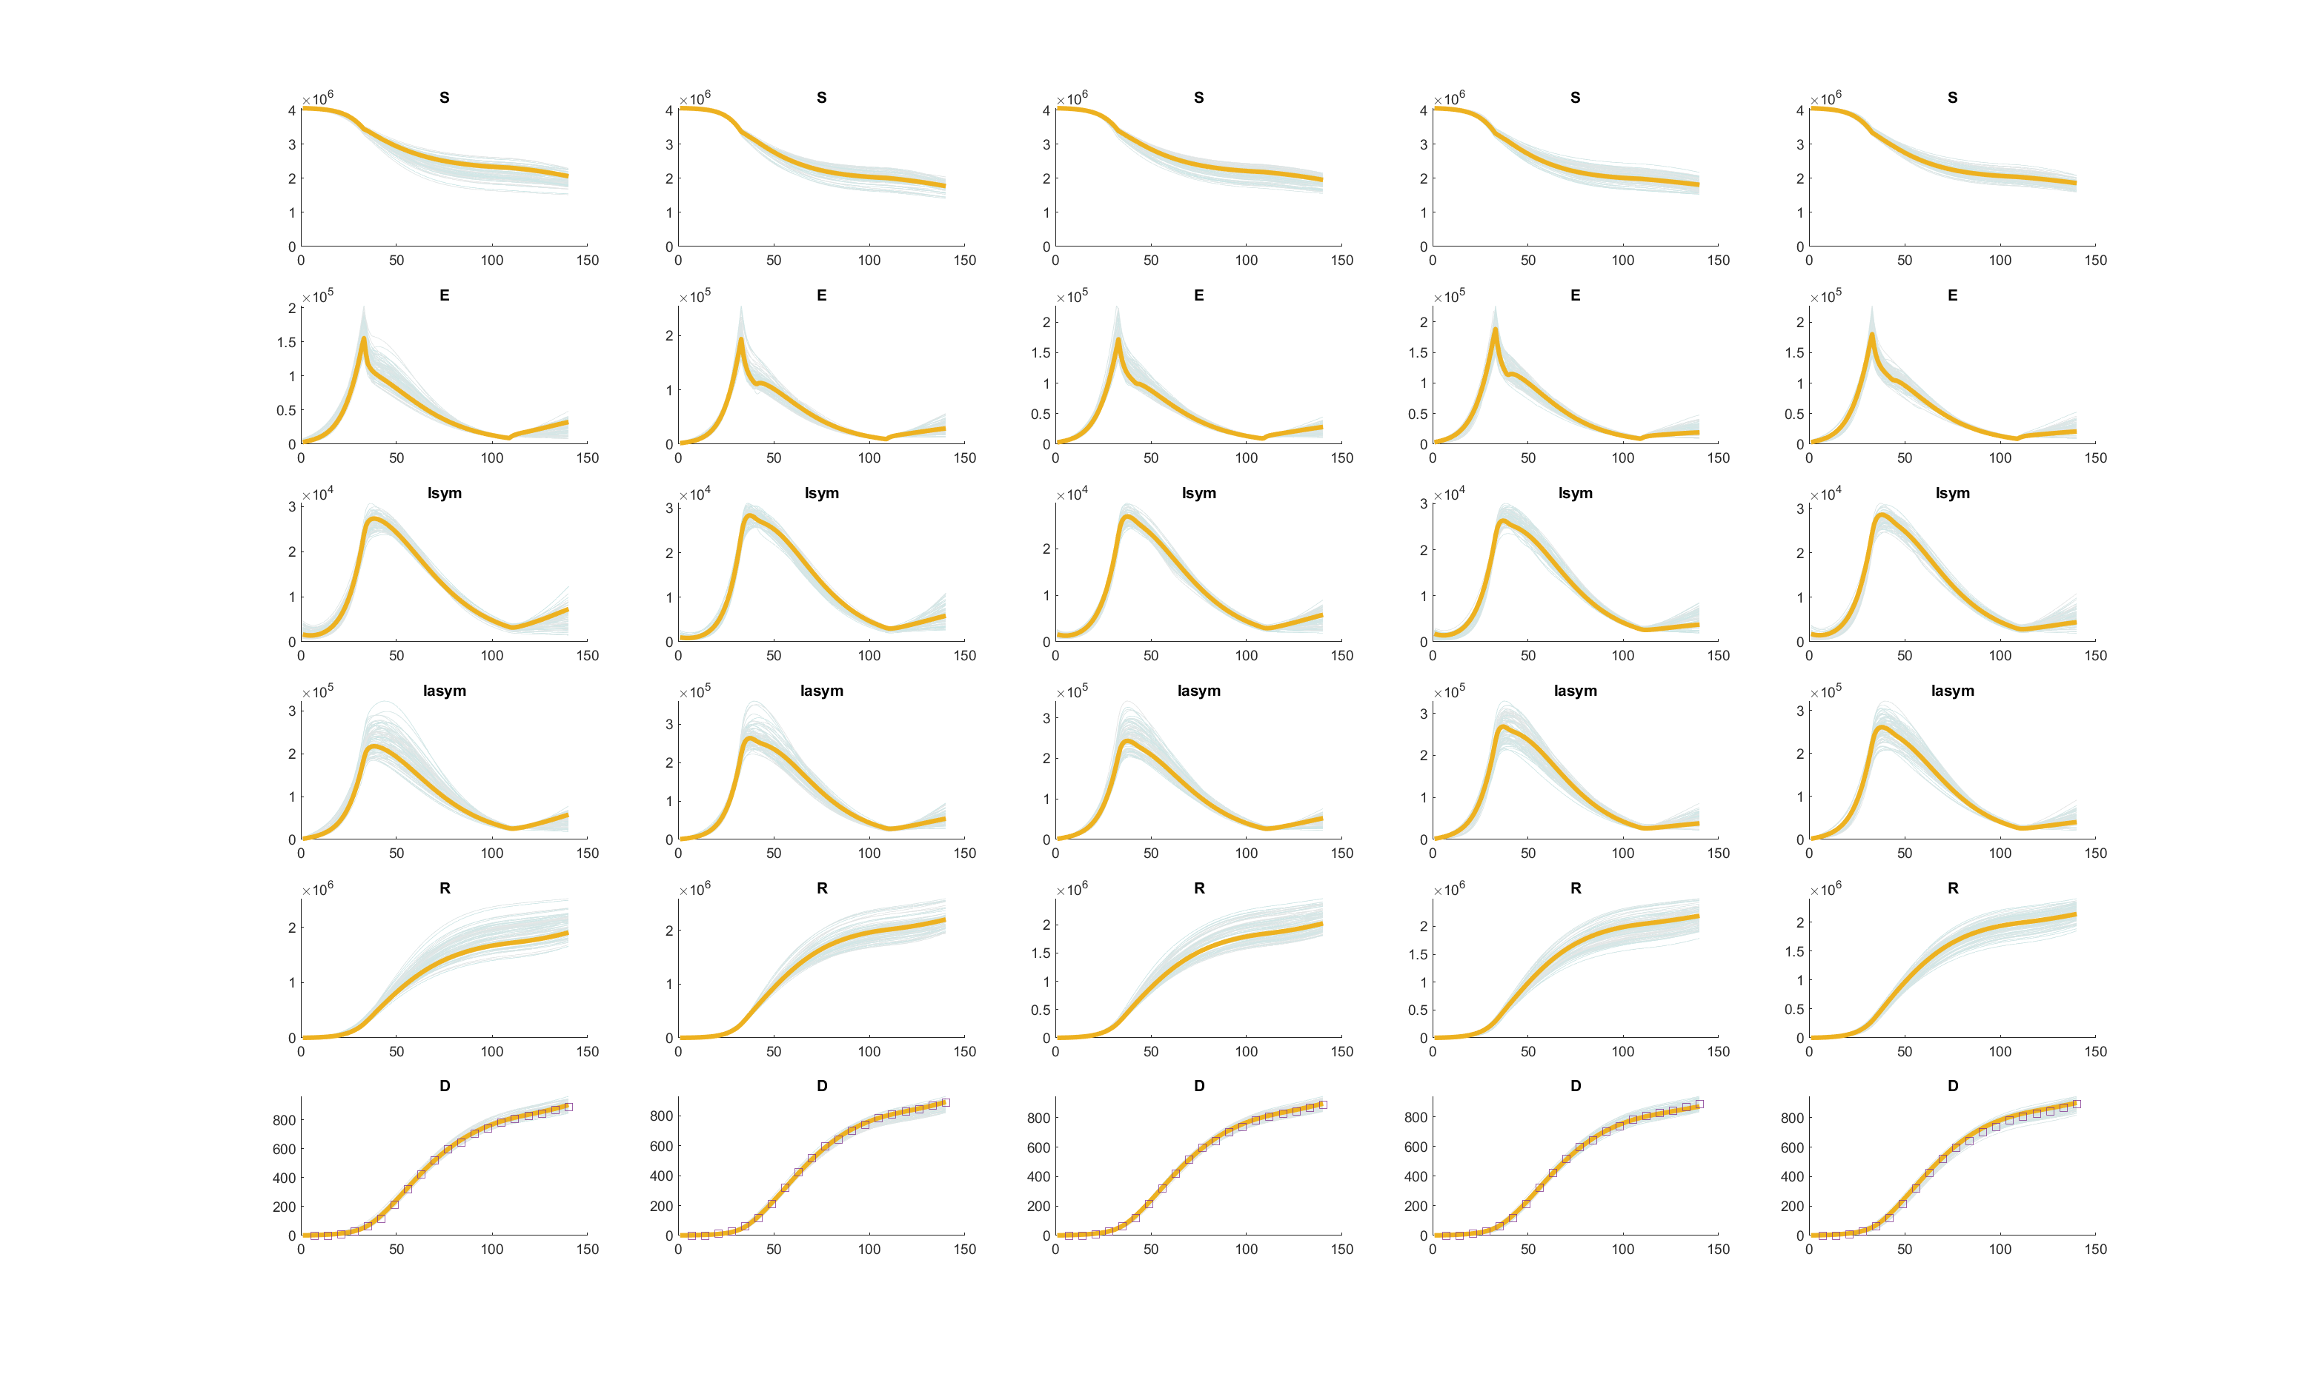

Slide 7
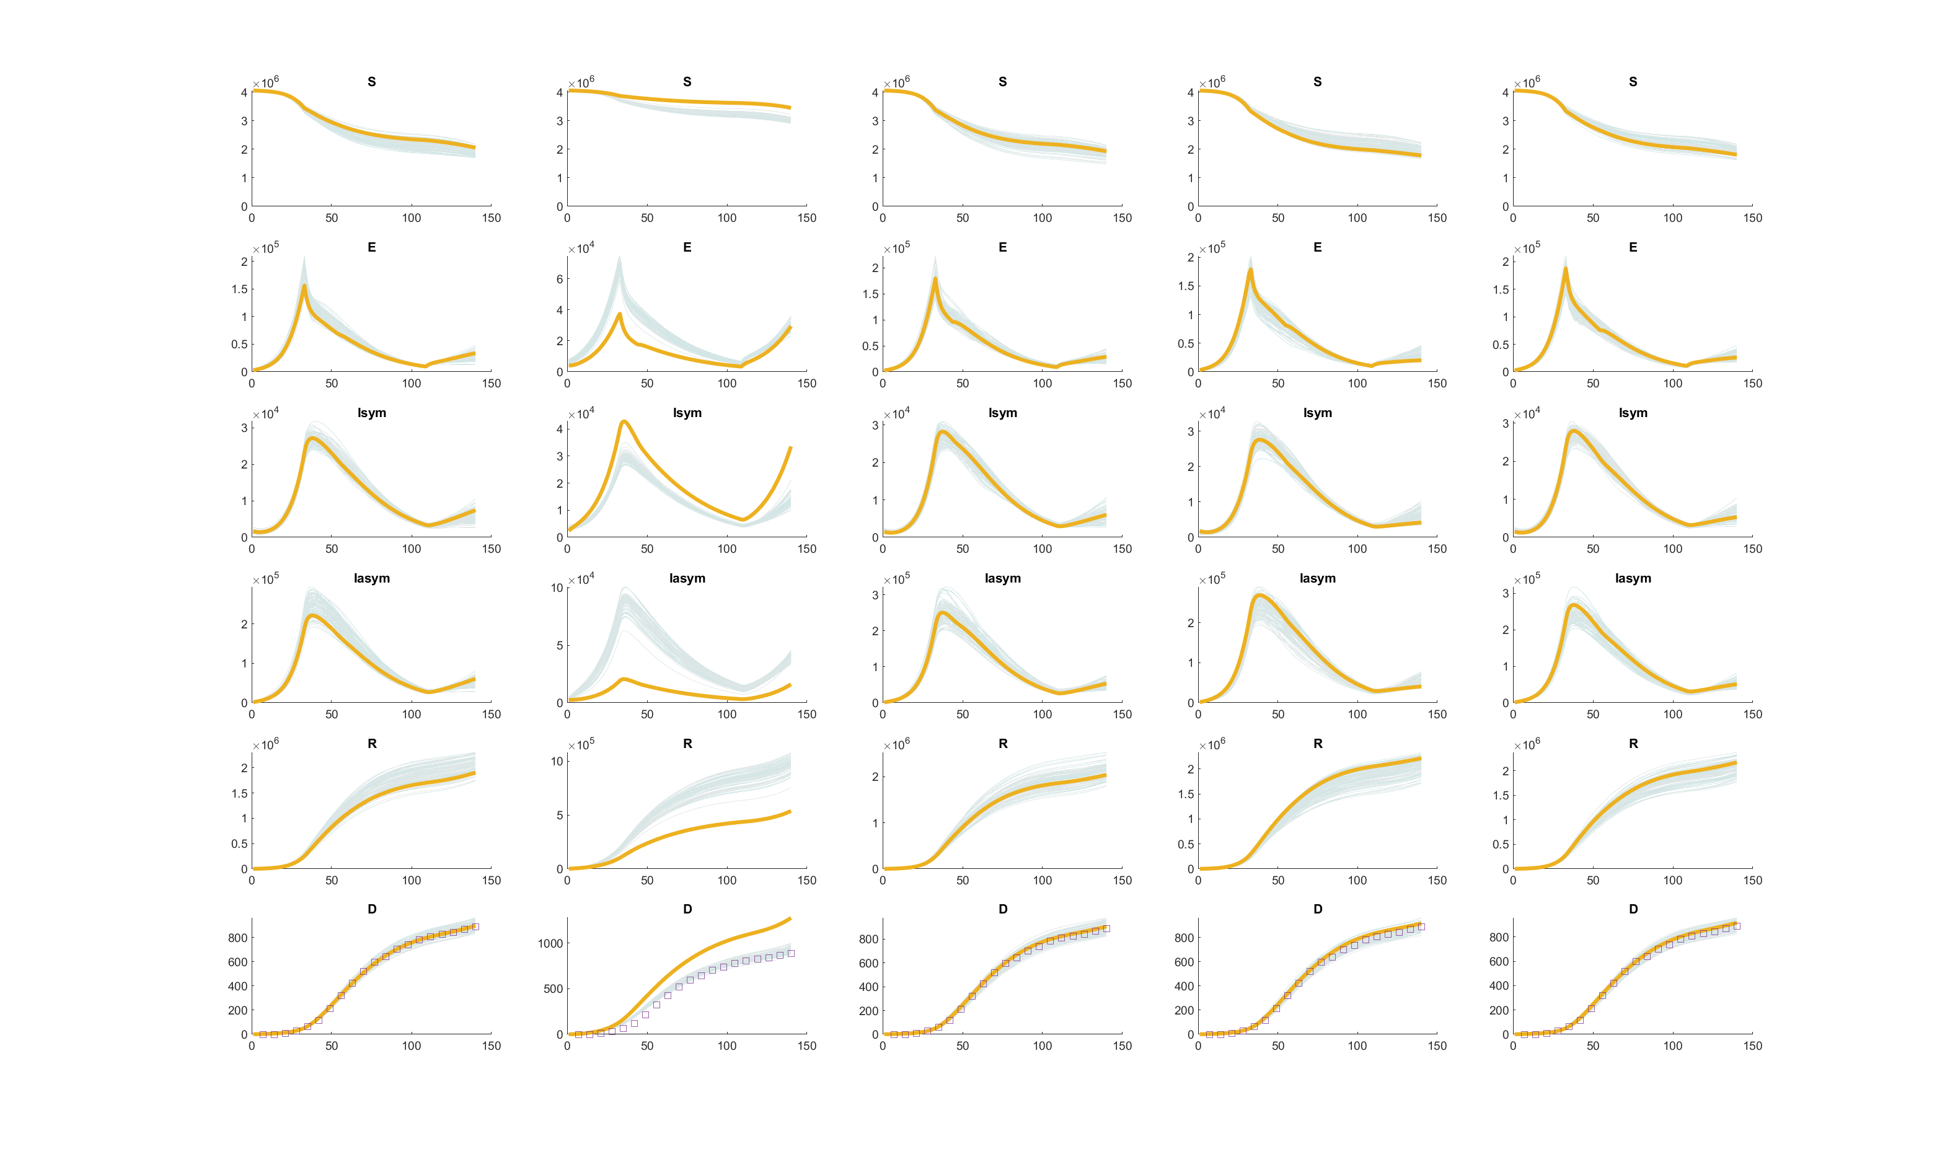

Slide 8
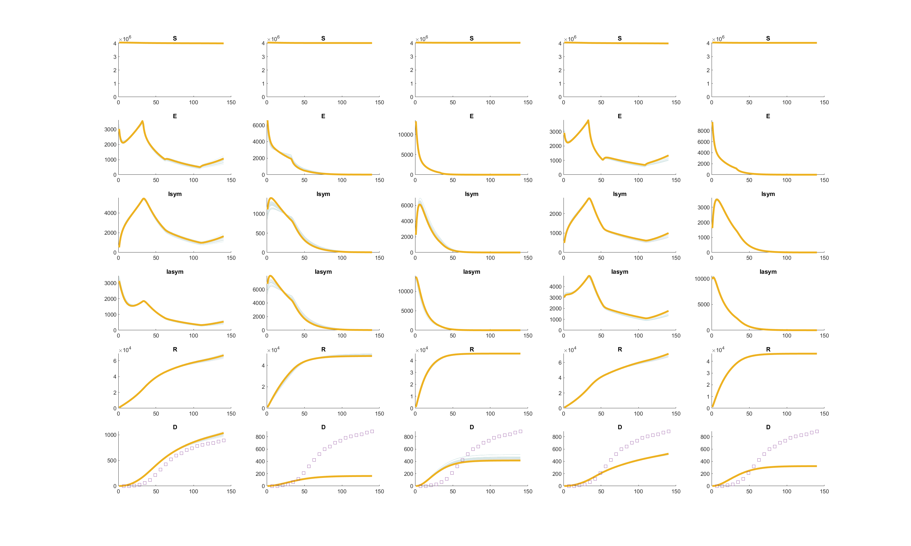

Slide 9
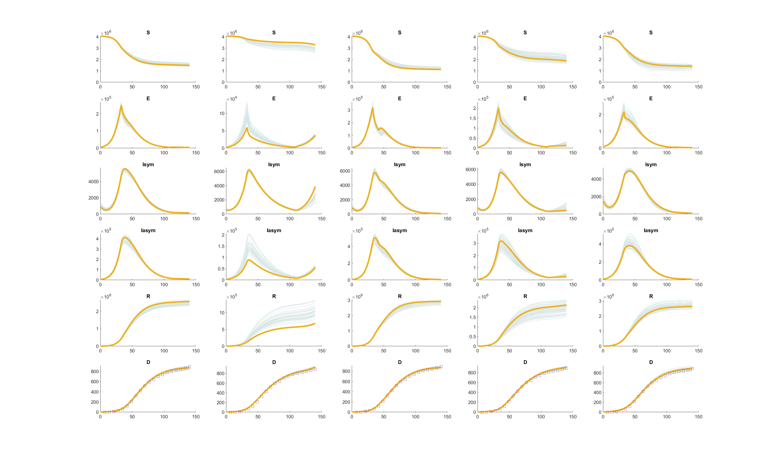

Slide 10
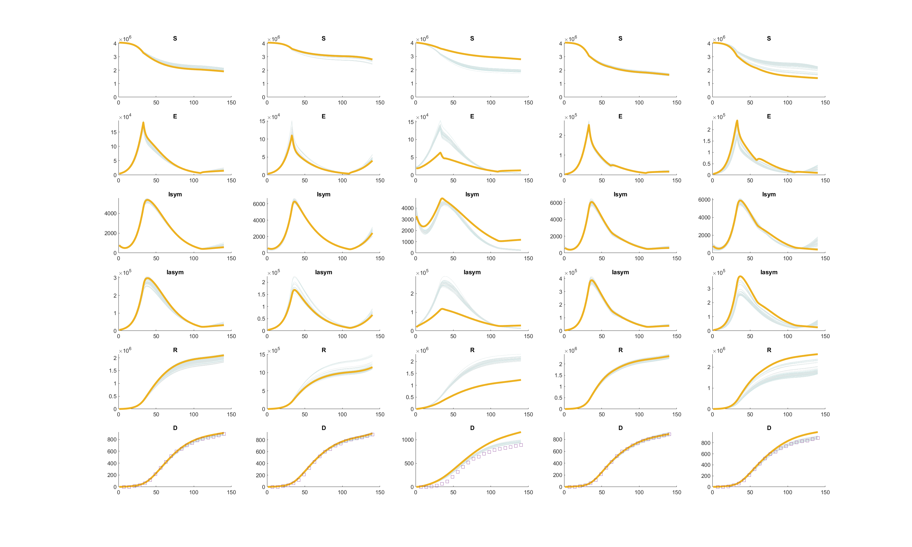

Slide 11
nyc

Slide 12
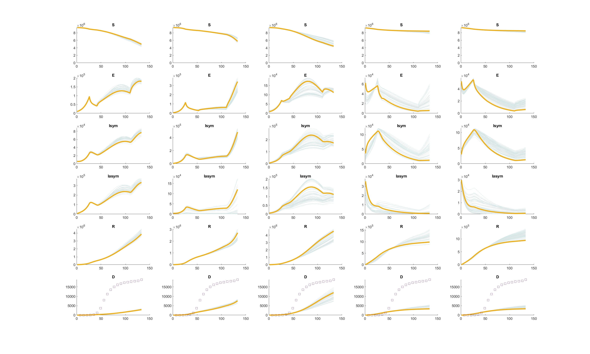

Slide 13
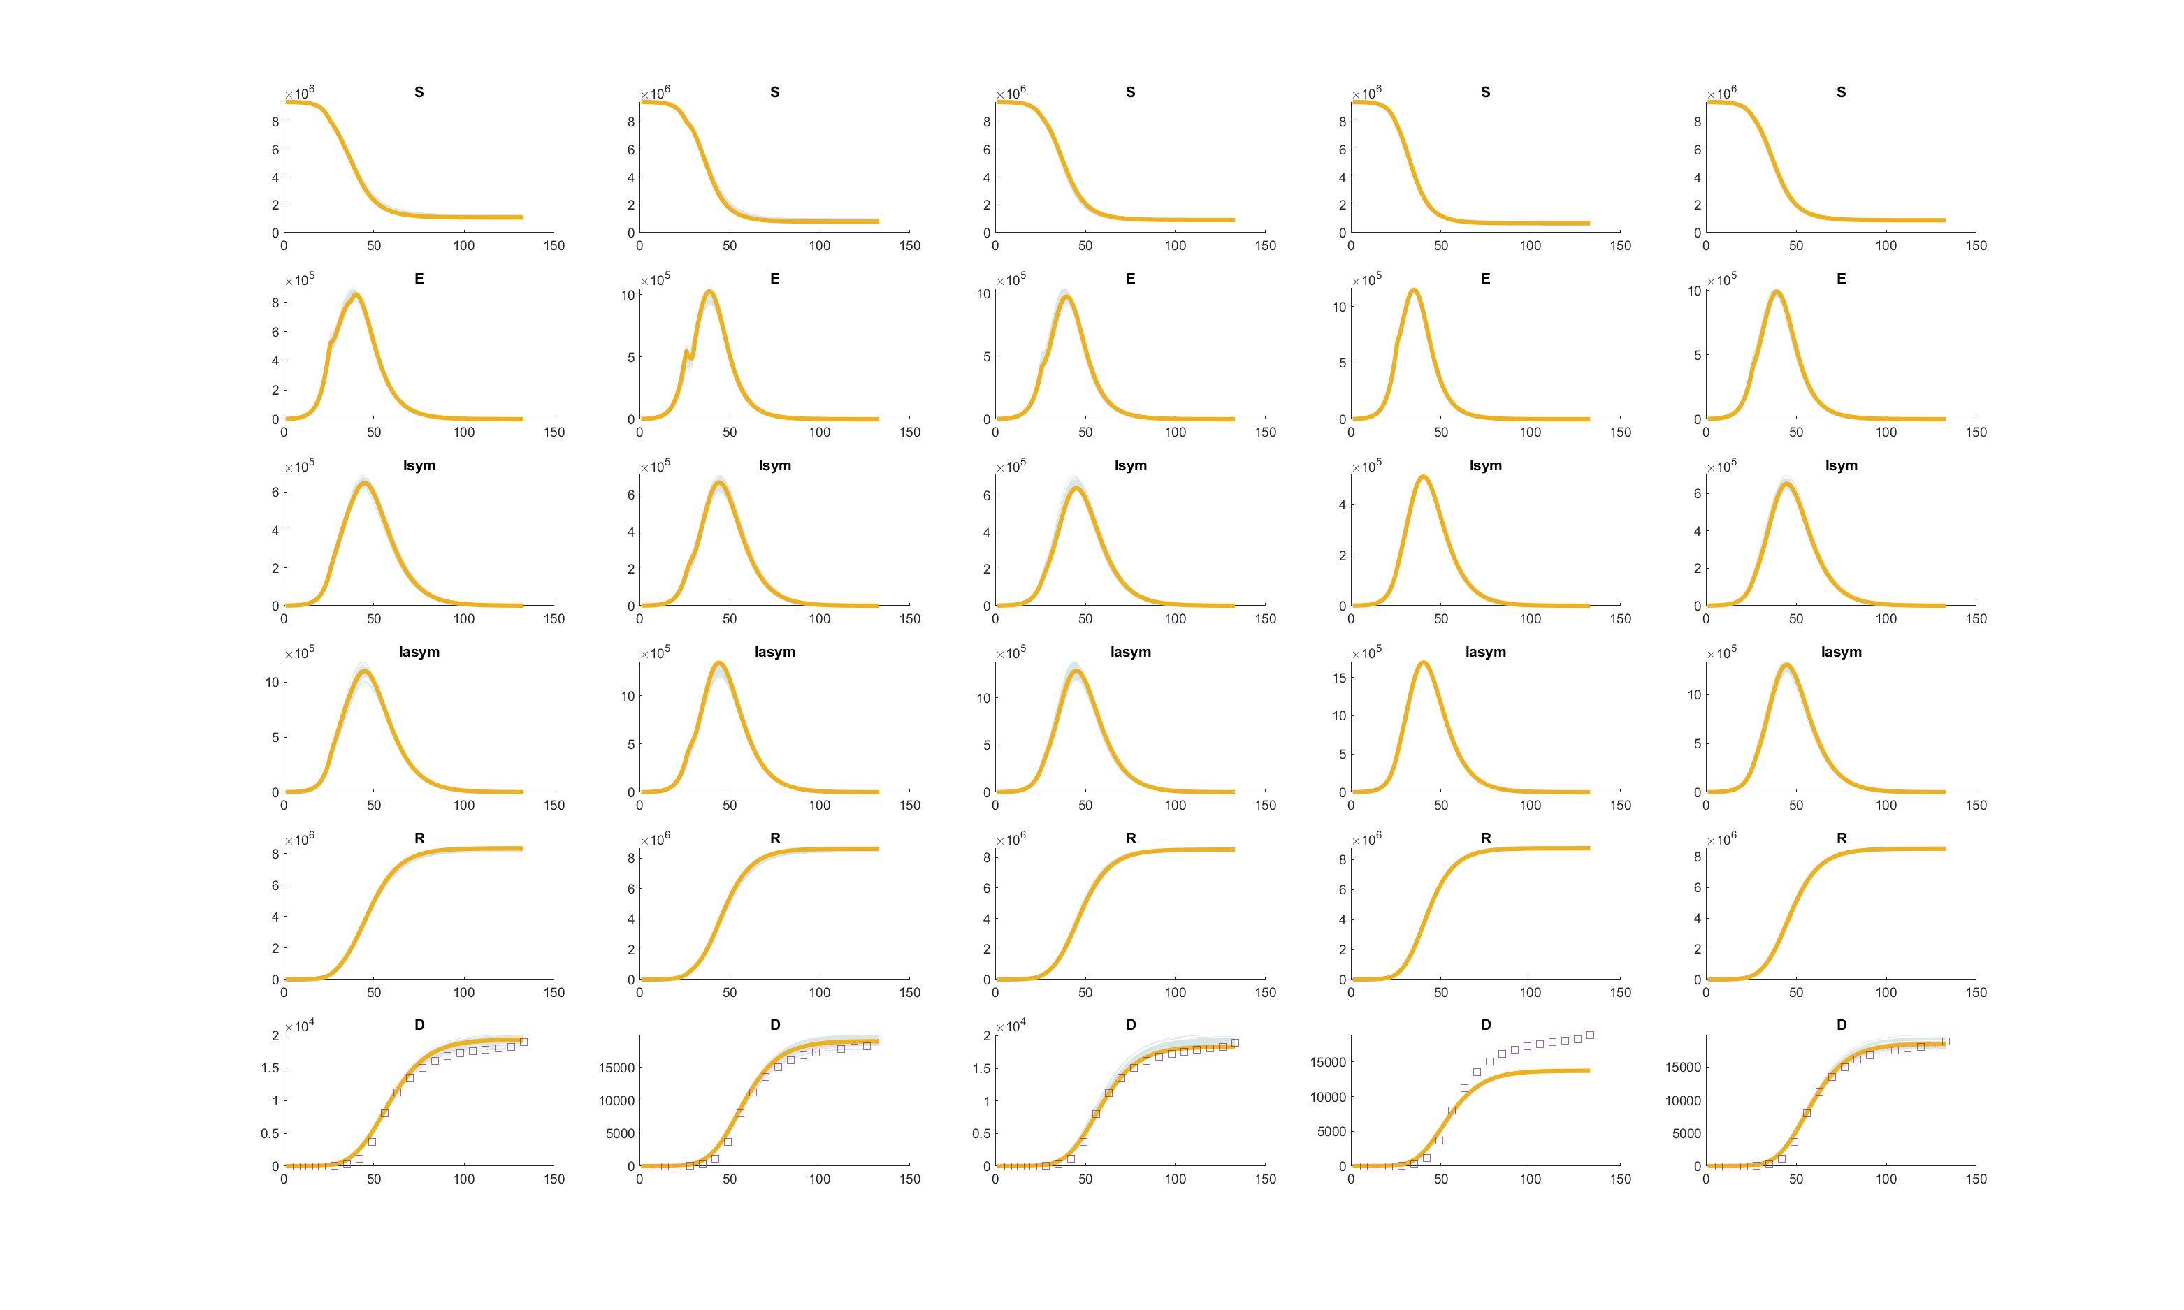

Slide 14
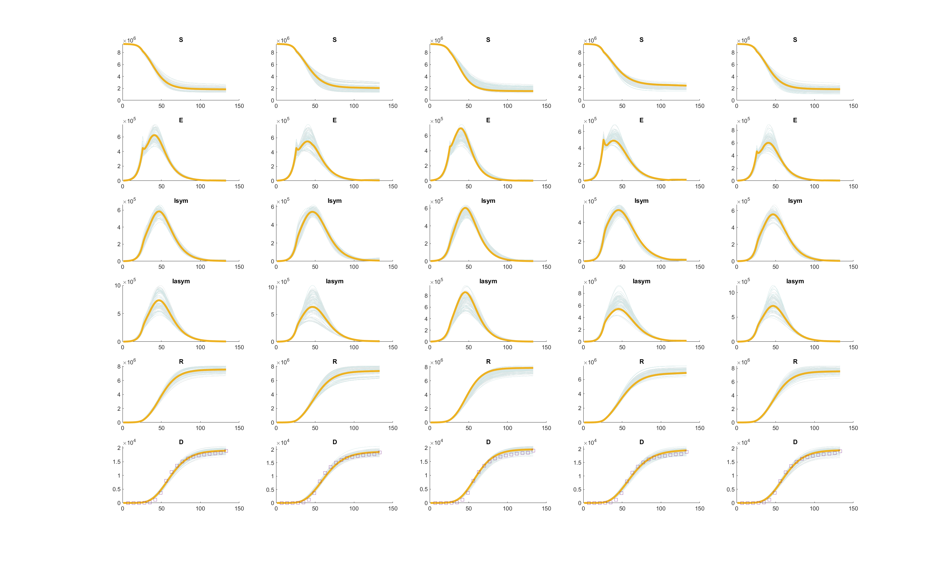

Slide 15
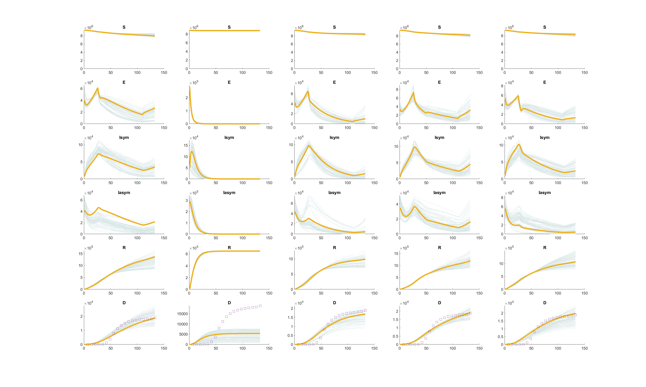

Slide 16
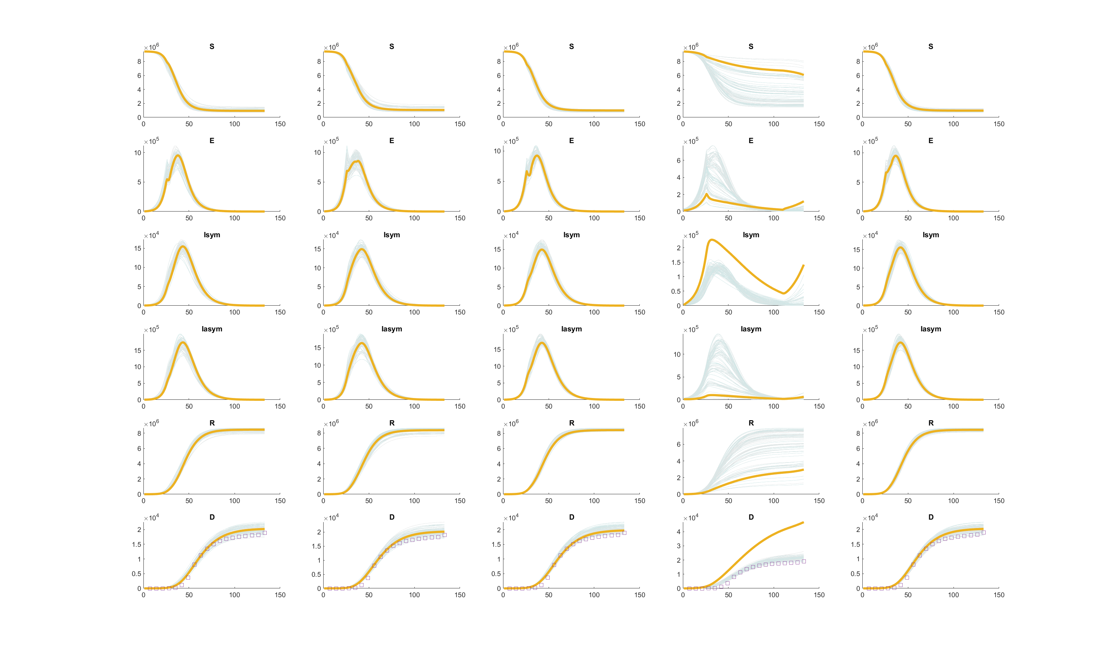

Slide 17
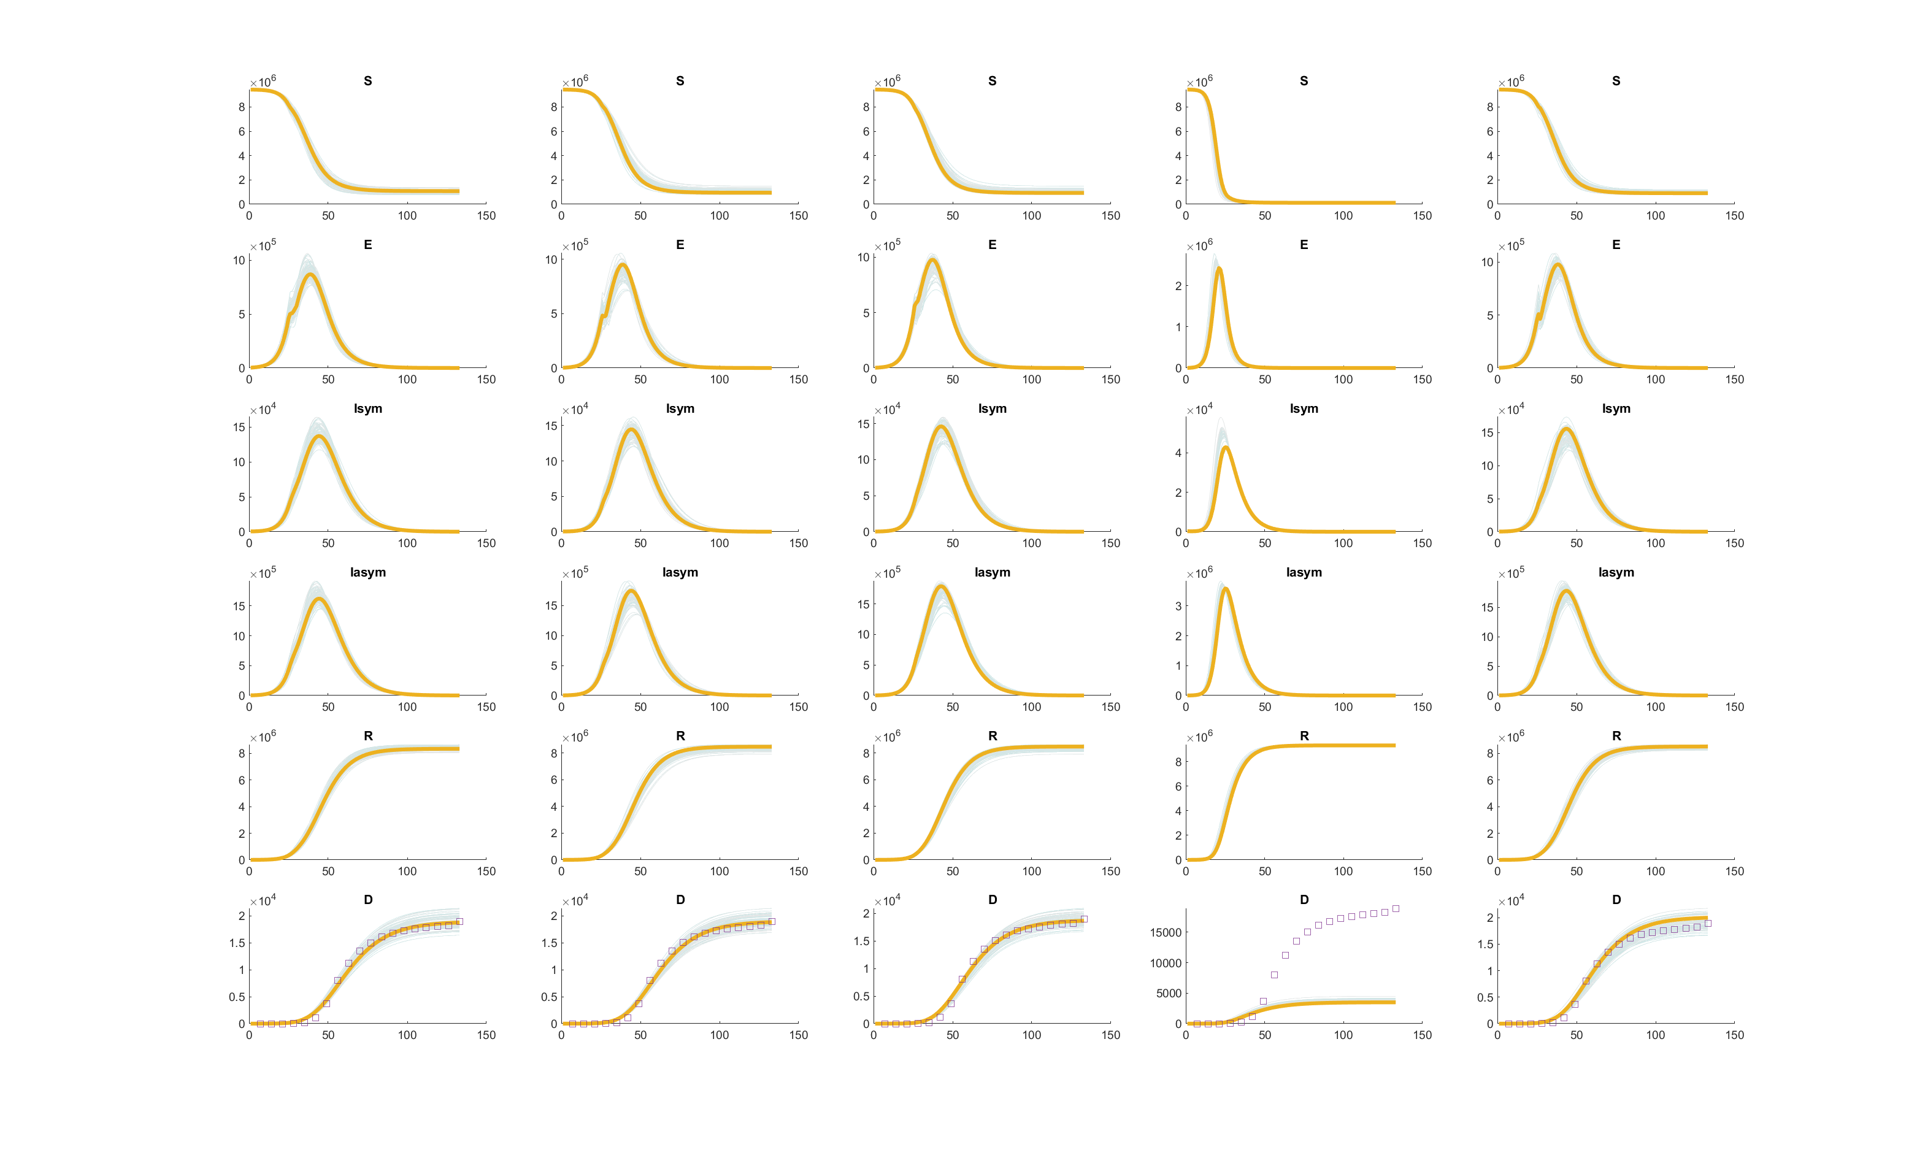

Slide 18
sflor

Slide 19
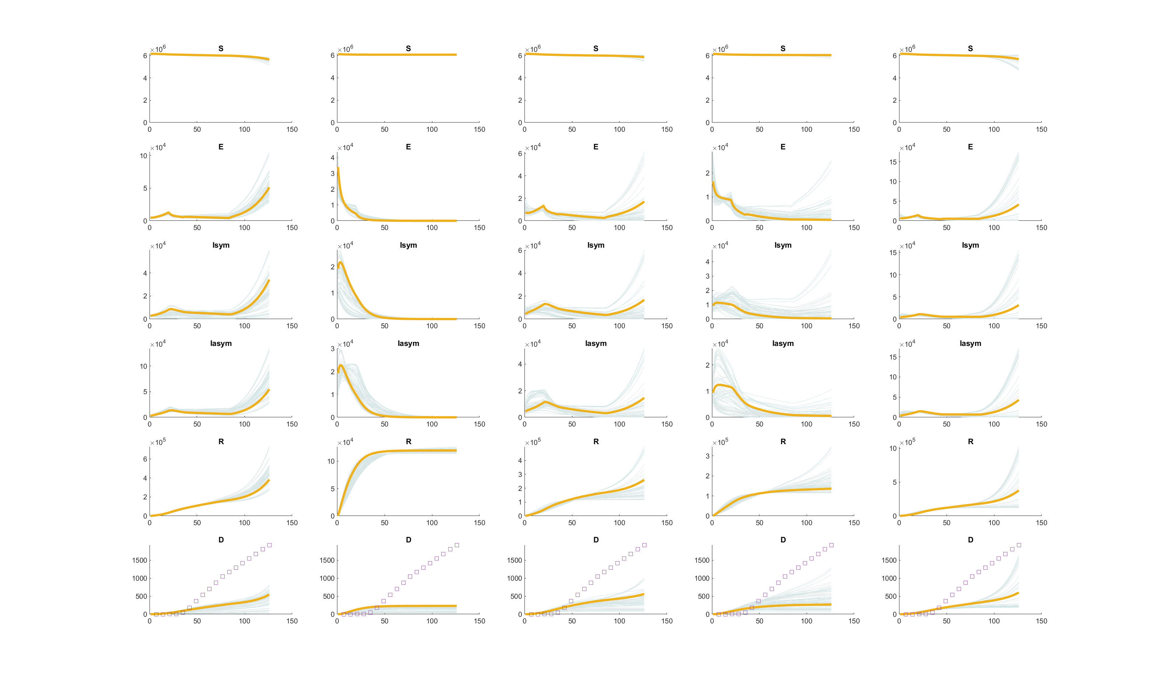

Slide 20
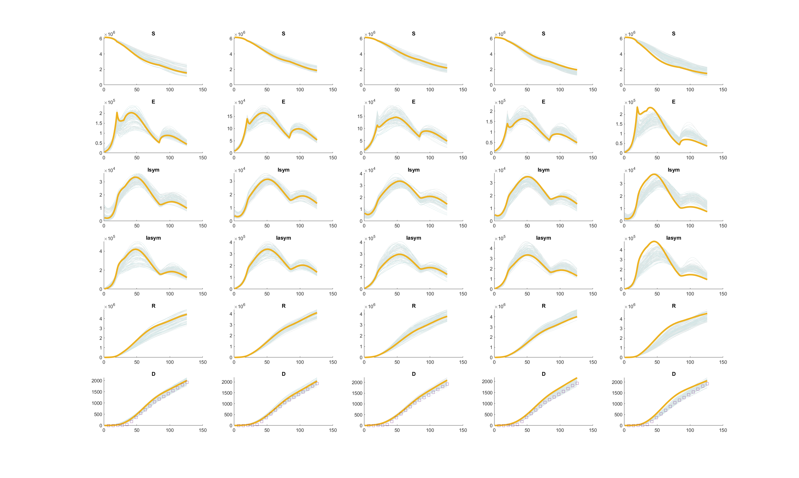

Slide 21
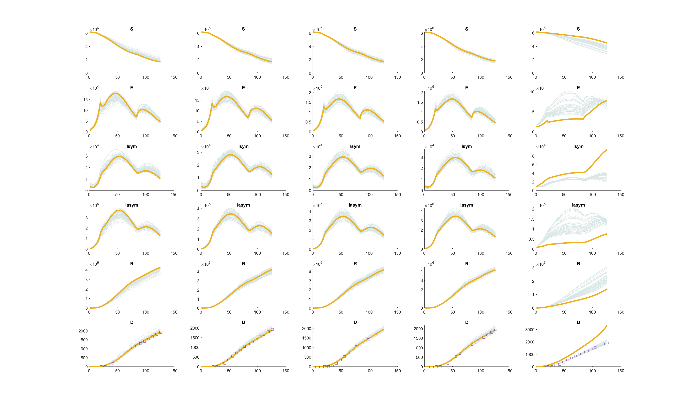

Slide 22
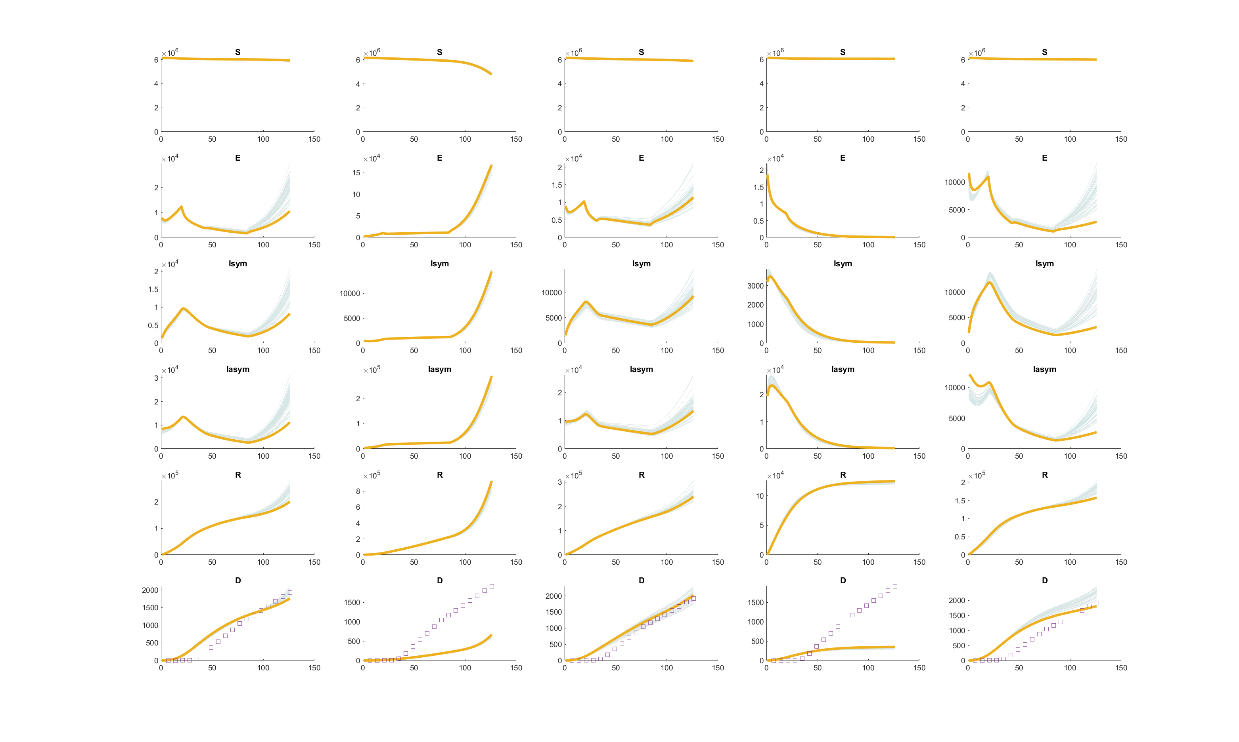

Slide 23
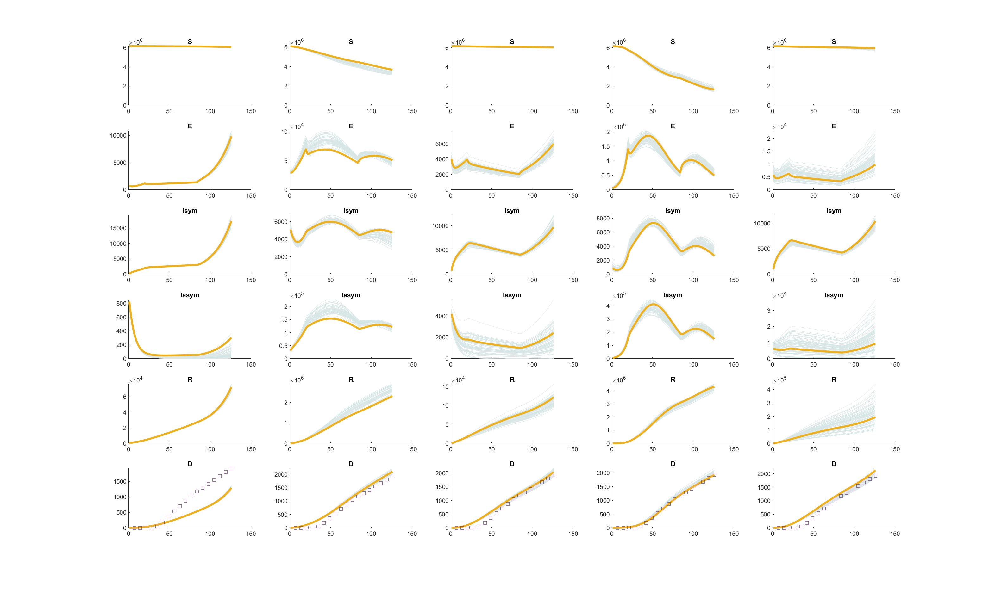

Slide 24
